Slide 1
Duomenų analizė ir Mokymasis naudojant stebėjimus ?
Mokymosi modulis realizuoja mokymosi algoritmus kuriuos suskirstysime į tris mokymosi tipus:
Mokymasis su mokytoju.
Autonominis mokymasis.
Reaktyvus aplinkai mokymasis.
Pagalvokime, o ką mes darėme su SQL iki šiol ?

Slide 2
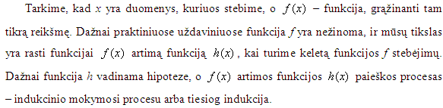
Indukcinis mokymasis ir Okamo skustuvas

Slide 3
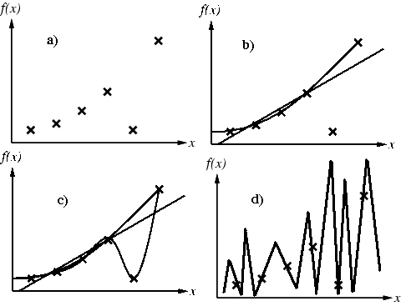
Indukcinis mokymasis ir Okamo skustuvas

Slide 4
Asociacijos taisyklės
X => Y
X = {x₁, x₂, …, x_{n}}
Y = {y₁, y₂, …, y_{n}}
x_{i} ir y_{j} unikalūs atributai
X (LHS)
Y (RHS)

Slide 5
Transaction ID | Items Bought
1 | Milk, bread, cookies, juice
2 | Milk, juice
3 | Milk, eggs
4 | Bread, cookies, coffee

Slide 6
Taisyklės metrikos
Support
Kaip dažnai sutinkama duomenų bazėje
LHS ∪ RHS
Confidence
Tikimybė kad LHS => RHS

Slide 7
Support
Taisyklės
Milk => juice
Bread => juice
{milk, juice}
2 / 4 = 0.50
{bread, juice}
1 / 4 = 0.25
Transaction ID | Items Bought
1 | Milk, bread, cookies, juice
2 | Milk, juice
3 | Milk, eggs
4 | Bread, cookies, coffee

Slide 8
Confidence
Taisyklės
Milk => juice
Bread => juice
Milk => juice
0.50 / 0.75 = 0.67
Bread => juice
0.25 / 0.50 = 0.50
Transaction ID | Items Bought
1 | Milk, bread, cookies, juice
2 | Milk, juice
3 | Milk, eggs
4 | Bread, cookies, coffee

Slide 9
Apriori Algoritmas
Fiksuojame minimalų būtiną skaičių su kuriuo taisyklė turi pasirodyti duomenų bazėje
Didiname po vieną atributą kiekvieną kartą ir surenkame rinkinius kurie tenkina užduotą dažnumo parametrą

Slide 10
Apriori Algoritmas
DB: {1,2,3,4}, {1,2}, {2,3,4}, {2,3}, {1,2,4}, {3,4}, and {2,4}
Min dažnumas = 3
Item | Support
1 | 3
2 | 6
3 | 4
4 | 5
Item | Support
{1,2} | 3
{1,3} | 1
{1,4} | 2
{2,3} | 3
{2,4} | 4
{3,4} | 3
Item | Support
{2,3,4} | 2
In the example, there are no frequent triplets. {2,3,4} is below the minimal threshold, and the other triplets were excluded because they were super sets of pairs that were already below the threshold.

Slide 11
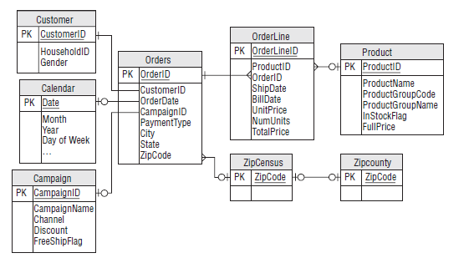
This entity-relationship diagram shows the relationship among entities in the
purchase dataset. Each entity corresponds to one table

Slide 12
A customer might purchase many different products and any given product might be purchased by many different customers.
In fact, the purchase dataset does have a many-to-many relationship between Orders and Products;
this relationship is represented by the Orderline entity, which has a zero/one-to-many relationship with each of those.

Slide 13
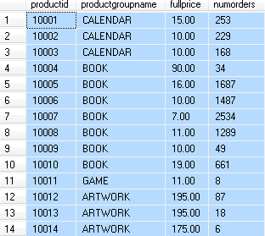
Exploratory Market Basket Analysis p 402
SELECT p.productid, p.productgroupname, p.fullprice, olp.numorders FROM
(SELECT ol.productid, COUNT(DISTINCT orderid) as numorders FROM orderline ol GROUP BY ol.productid) olp JOIN
product p ON olp.productid = p.productid
ORDER BY p.productid
Kaip padaryti grafiką labiau informatyviu? Gal mažiau taškų? Pamėginkite.

Slide 14
What is the average number of units for products in a given order by product group?
Prieš žiūrėdami atsakymą pagalvokime kokios lentelės ir pagal ką grupuosime duomenis.
Manau studentai , kurie sukūrė savo sprendimą (net jei ir neteisingą) verti aukštesnio įvertinimo ?

Slide 15
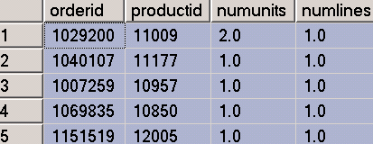
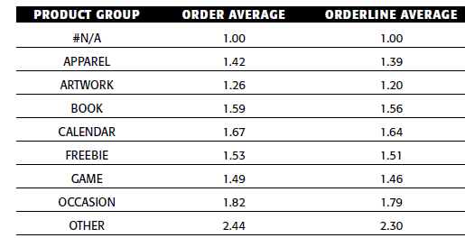
What is the average number of units for products in a given order by product group? P 408
SELECT productgroupname, AVG(ol.numunits) as orderaverage,
SUM(ol.numunits) / SUM(ol.numlines) as orderlineaverage
FROM (
SELECT ol.orderid, ol.productid, SUM(numunits)*1.0 as numunits,
COUNT(*)*1.0 as numlines
FROM orderline ol
GROUP BY ol.orderid, ol.productid
) ol JOIN
product p ON ol.productid = p.productid
GROUP BY productgroupname
ORDER BY productgroupname

Slide 16
How many products are purchased exactly once by a household that never purchases anything else?

Slide 17
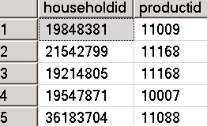
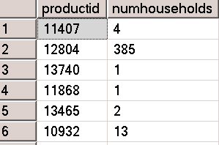
How many products are purchased exactly once by a household that never purchases anything else?
1.
SELECT p.productid, numhouseholds, COALESCE(numuniques, 0) as numuniques,
COALESCE(numuniques*1.0, 0.0) / numhouseholds as prodratio INTO ##AA
FROM (SELECT productid, COUNT(*) as numhouseholds
FROM (SELECT c.householdid, ol.productid
FROM customer c JOIN
orders o ON c.customerid = o.customerid JOIN
orderline ol ON o.orderid = ol.orderid
GROUP BY c.householdid, ol.productid) hp GROUP BY productid) p
LEFT OUTER JOIN
(SELECT productid, COUNT(*) as numuniques
FROM (SELECT householdid, MIN(productid) as productid
FROM customer c JOIN
orders o ON c.customerid = o.customerid JOIN
orderline ol ON o.orderid = ol.orderid
GROUP BY householdid
HAVING COUNT(DISTINCT ol.productid) = 1 AND
COUNT(DISTINCT o.orderid) = 1) h
GROUP BY productid) hp
ON hp.productid = p.productid
ORDER BY 4 DESC

Slide 18
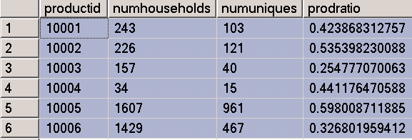
SELECT * from ##AA ORDER BY productid
productid – unikalus producto id
numhouseholds – kiek namų ūkių tą produktą pirko
numuniques – kiek namų ūkių kurie pirko tik tą produktą ir nieko daugiau
prodratio = numhouseholds / numuniques

Slide 19
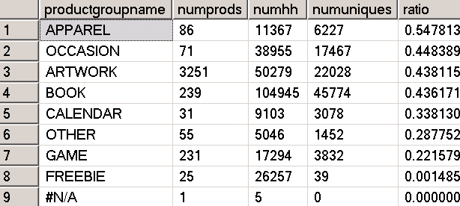
How many products are purchased exactly once by a household that never purchases anything else?
2.
SELECT productgroupname, COUNT(*) as numprods, SUM(numhouseholds) as numhh, SUM(numuniques) as numuniques,
SUM(numuniques*1.0)/SUM(numhouseholds) as ratio
FROM ##AA hp JOIN product p
ON hp.productid = p.productid
GROUP BY productgroupname
ORDER BY 5 DESC

Slide 20
How many products are purchased exactly once by a household that never purchases anything else?
3.
productgroupname | numprods | numhh | numuniques | ratio
APPAREL | 86 | 11,367 | 6,227 | 54.8%
OCCASION | 71 | 38,955 | 17,467 | 44.8%
ARTWORK | 3,251 | 50,279 | 22,028 | 43.8%
BOOK | 239 | 104,945 | 45,774 | 43.6%
CALENDAR | 31 | 9,103 | 3,078 | 33.8%
OTHER | 55 | 5,046 | 1,452 | 28.8%
GAME | 231 | 17,294 | 3,832 | 22.2%
FREEBIE | 25 | 26,257 | 39 | 0.1%
#N/A | 1 | 5 | NULL | NULL
The proportion of households that purchase only one product varies
considerably by product group. Some groups such as APPAREL are associated with
such unique purchasers.

Slide 21
Combinations (Item Sets) p 415

Slide 22
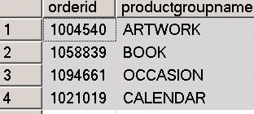
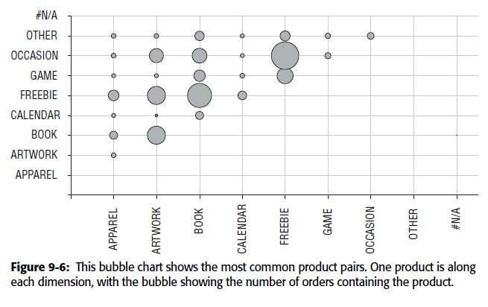
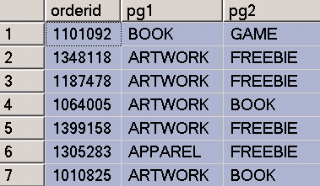
Combinations of Product Groups 420 p
SELECT pg1, pg2, COUNT(*) as cnt
FROM (SELECT op1.orderid, op1.productgroupname as pg1,
op2.productgroupname as pg2
FROM (SELECT orderid, productgroupname FROM orderline ol JOIN
product p ON ol.productid = p.productid
GROUP BY orderid, productgroupname) op1 JOIN
(SELECT orderid, productgroupname FROM orderline ol JOIN
product p ON ol.productid = p.productid
GROUP BY orderid, productgroupname) op2
ON op1.orderid = op2.orderid AND
op1.productgroupname < op2.productgroupname
) combinations
GROUP BY pg1, pg2

Slide 23
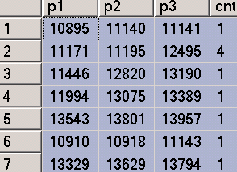
Multi-Way Combinations 423 p
SELECT p1, p2, p3, COUNT(*) as cnt FROM
(SELECT op1.orderid, op1.productid as p1, op2.productid as p2, op3.productid as p3
FROM
(SELECT orderid, COUNT(DISTINCT productid) as numprods FROM orderline GROUP BY orderid HAVING COUNT(DISTINCT productid) > 2) o
JOIN
(SELECT DISTINCT orderid, productid FROM orderline) op1 ON o.orderid = op1.orderid
JOIN
(SELECT DISTINCT orderid, productid FROM orderline) op2
ON op1.orderid = op2.orderid AND
op1.productid < op2.productid JOIN
(SELECT DISTINCT orderid, productid FROM orderline) op3
ON op2.orderid = op3.orderid AND
op2.productid < op3.productid
) combinations
GROUP BY p1, p2, p3

Slide 24
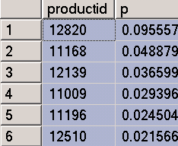
Zero-Way Association Rules 429 p
SELECT productid, COUNT(*)/MAX(numorders) as p
FROM (SELECT DISTINCT orderid, productid FROM orderline) op CROSS JOIN
(SELECT COUNT(*)*1.0 as numorders FROM orders o) o
GROUP BY productid
ORDER BY 2 DESC

Slide 25

One-Way Association Rules 431 p
Viena taisyklė Product 12820 ➪ Product 13190
SELECT COUNT(*) as numorders, SUM(lhs) as numlhs, SUM(rhs) as numrhs,
SUM(lhs*rhs) as numlhsrhs
FROM (SELECT orderid,
MAX(CASE WHEN productid = 12820 THEN 1 ELSE 0 END) as lhs,
MAX(CASE WHEN productid = 13190 THEN 1 ELSE 0 END) as rhs
FROM orderline ol
GROUP BY orderid) o
SUM(lhs*rhs) t.y. 1*1 jei kairė ir dešinė taisyklės pusės yra konkrečioje duomenų eilutėje.

Slide 26
Generating All One-Way Rules 433
-------- SELECT * FROM ##Rules order by 4 desc
SELECT (CAST(lhs as VARCHAR)+' --> '+ CAST(rhs as VARCHAR)) as therule,
lhs, rhs, COUNT(*) as numlhsrhs
INTO ##Rules
FROM (SELECT item_lhs.orderid, item_lhs.lhs, item_rhs.rhs
FROM (SELECT orderid, productid as lhs FROM orderline
GROUP BY orderid, productid) item_lhs JOIN
(SELECT orderid, productid as rhs FROM orderline
GROUP BY orderid, productid) item_rhs
ON item_lhs.orderid = item_rhs.orderid AND
item_lhs.lhs <> item_rhs.rhs
) rules
GROUP BY lhs, rhs

Slide 27
One-Way Rules with Evaluation Information
SELECT lhsrhs.*, numorders, numlhs, numrhs,
numlhsrhs*1.0/numorders as support,
numlhsrhs*1.0/numlhs as confidence,
numlhsrhs * numorders * 1.0/(numlhs * numrhs) as lift
FROM (SELECT lhs, rhs, COUNT(*) as numlhsrhs
FROM (SELECT * FROM ##Rules) rules GROUP BY lhs, rhs) lhsrhs JOIN
(SELECT productid as lhs, COUNT(DISTINCT orderid) as numlhs
FROM orderline GROUP BY productid) sumlhs
ON lhsrhs.lhs = sumlhs.lhs JOIN
(SELECT productid as rhs, COUNT(DISTINCT orderid) as numrhs
FROM orderline GROUP BY productid) sumrhs
ON lhsrhs.rhs = sumrhs.rhs CROSS JOIN
(SELECT COUNT(DISTINCT orderid) as numorders FROM orderline) a

